Slide 1
MAAS-Hub Scalable homogenous architecture for multi agent systems
Moazzam Abdullah Khan
Daiem Nadir Ali
Nour Soufi
Segun Ajibola

Slide 2
Challenge
Customer places order
Orders require multiple steps to complete
Agents have to complete the order
Agents have specializations
Transporting
Can move
Painting
Can paint
Fastening
Can fasten two objects together
Deliver finished order to customer

Slide 3
Assumptions
Unlimited resources
All orders can be completed
No need to prioritize orders to maximize profit
Release time
Orders are released with individual specified delays
No deadlines
Orders don’t have a deadline attached
No need to prioritize orders to maximize profit
Fixed processing time
Each step has a specific completion delay
Location and distance doesn’t affect step completion time

Slide 4
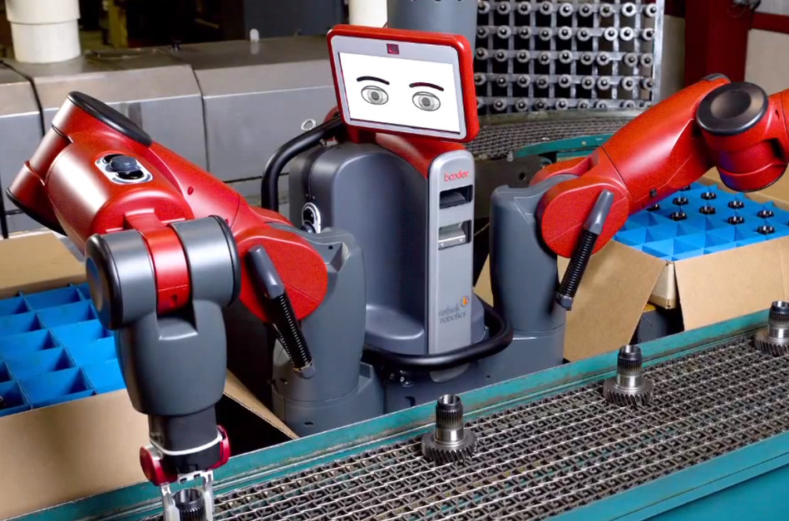
Our Motivations
Keep agents
Homogenous
Versatile
Indefinitely scalable
Baxter Robot: A versatile robot worker capable of doing complex tasks

Slide 5
Structure
Simple Agent
Comms
Queue Agent
Comms
Action Definitions
Priority Queue
Role

Slide 6
Class Diagram
Order Generator
Random Number Generator
Priority Queue
Acquisition Queue
Simple
Worker
Delivery Queue
OutwardQueGUI
Order

Slide 7
Worker Roles
Simple Worker States
Role
Capability
Transporter
Painter
Fastener
Active Strategy
Passive Strategy

Slide 8
Command and Control
Every agent registers on yellow pages
Queue holds information on agent inventories
Objects have a number representing overall progress (step number) which is currently treated as priority
Queue
Nut:1
Red Nut:2
Fastener
Nut:1
Painter
Red Nut:2

Slide 9


Flow

Slide 10
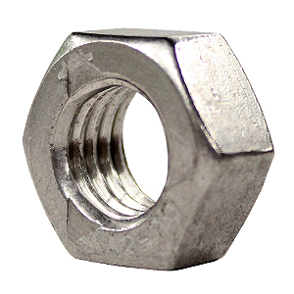
Flow

Slide 11
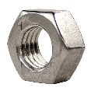
Flow

Slide 12
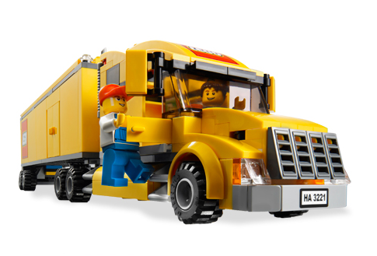


Flow

Slide 13
Flow

Slide 14
Flow
?

Slide 15
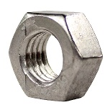
Flow
?

Slide 16

Flow
?

Slide 17
Flow
?

Slide 18
Flow
?

Slide 19
Flow

Slide 20
Flow

Slide 21
Flow

Slide 22
Flow

Slide 23
Flow

Slide 24
Flow
?

Slide 25
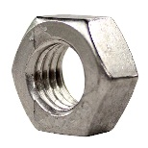
Flow
?

Slide 26

Flow
?

Slide 27
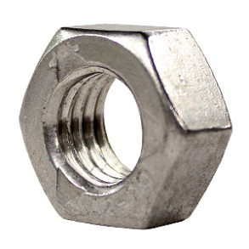
Flow
?

Slide 28

Flow
?

Slide 29
Flow
?

Slide 30
Peculiarities
Advantages
Yellow papers based communication
Centralized but robust
Micro contracts
Contract look ahead only 1 step
Little bandwidth overhead
Disadvantages
Deadline based prioritization isn’t implemented

Slide 31
Implementation
JADE issues
Minor implementation issues
Tools used
Ticker behaviors
RE Initiators
Priority Queues
Yellow pages
Finite State Machines

Slide 32
Lessons Learned
Scalable architecture
Can be used ideally in any scenario
Computational complexity restricts to relatively high end devices
ARM based devices ideal
Not suitable for microcontrollers
Deadlines can be accommodated by changing priority number

Slide 33
?

